Slide 1

Project Presentation
Ashwini
Kokila
Michael
Muralidhar
Yuan

Slide 2








We have to estimate the customers’ demand in newly arrived seasonal products

Slide 3
Estimating future customer demands involves a high factor of uncertainty
Issues:
Missing information
Redundancy of work
Time-consuming
Lots of paperwork
Prone to making errors
Estimating demand
Wrong order picked
Wrong billing

Slide 4
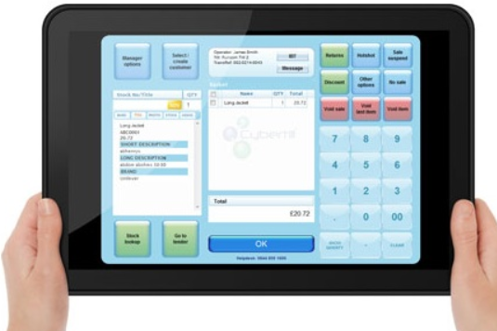
Solution/ To-be process
Implement a mobile application or web interface
Dedicated point of contact for customers
Central database for products and customers
Flexibility in ordering and billing
Deliver only to those who requested

Slide 5
Design of our database
customer
suppliers
Demand order
Supply
order
product

Slide 6
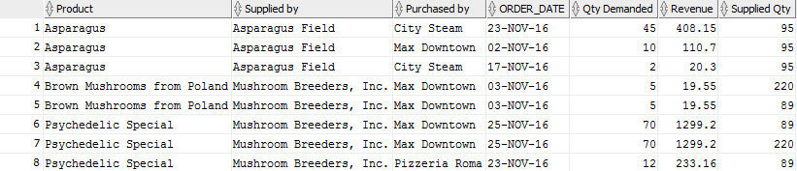
Overview of Orders
Who buys what?
How much is bought?
Who fulfilled the demand?
…… ……

Slide 7


Order-wise Cost
How much does each order cost to our company?

Slide 8
Find bestseller
Find loyal customer
Calculate the demand
…… ……

Slide 9



The total price of order 1 is $490.6.

Slide 10
Questions?

